Slide 1


Depth estimation from Lidar Measurement Code Explained
By Daniel Eneh
PhD Applicant

Slide 2
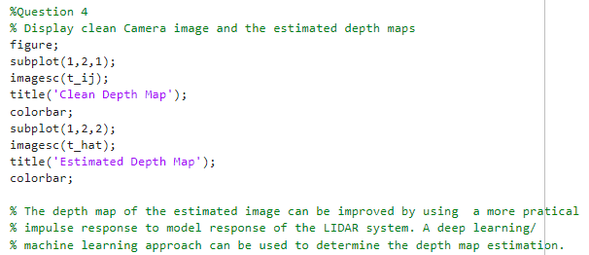
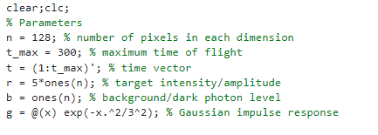
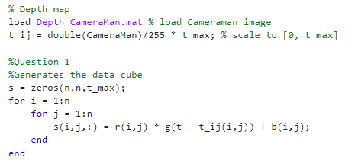
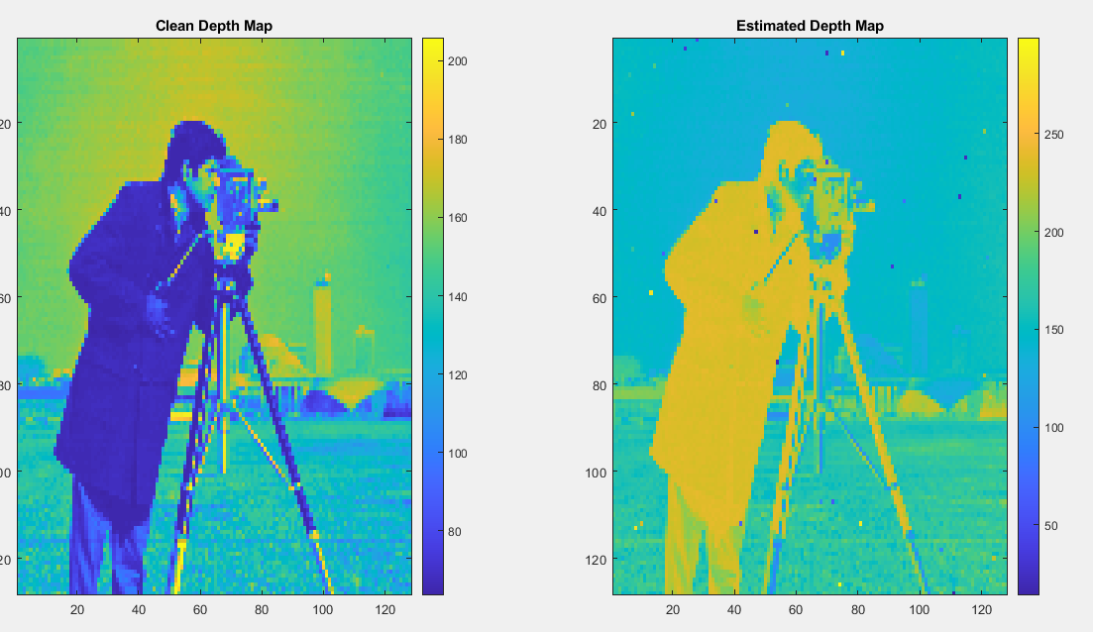

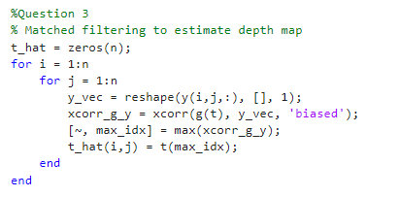

Define Parameters
Define Parameters
Define Parameters
Load the depth Map and generate the Data Cube
Load the depth Map and generate the Data Cube
Load the depth Map and generate the Data Cube
Generate Noisy Data Cube
Generate Noisy Data Cube
Generate Noisy Data Cube
Match Filtering Method to Estimate Depth Map
Match Filtering Method to Estimate Depth Map
Match Filtering Method to Estimate Depth Map
The depth map of the estimated image can be improved by using a more practical impulse response to model the response of the LIDAR system. A deep learning or machine learning approach can be used to determine the depth map estimation
Display Results
Display Results
Display Results

